Slide 1
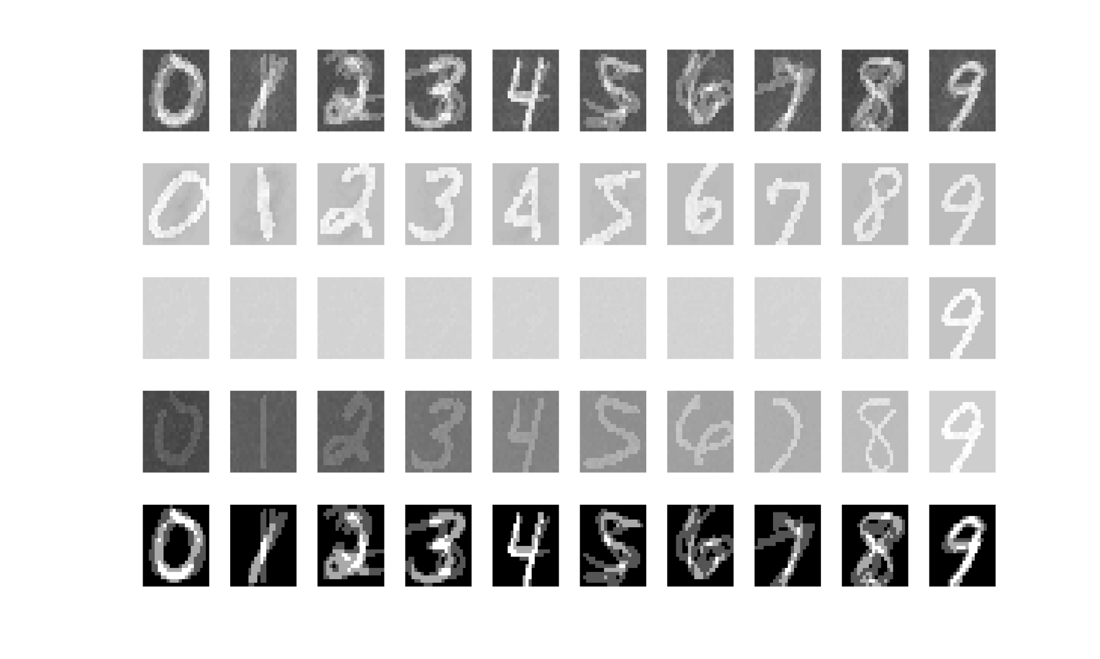

#1: Tonic burst + late
#3: Tonic burst
#2: Tonic tonic
#4: Tonic low tonic
Fig 2
Fig 4
TONIC
RF (last state in tonic) – before noise
#1
#2
#3
#4
Mean of the 3 sample digit presented
RF (last state in burst) – before noise
#1
#2
#3
#4
Mean of the 3 sample digit presented

Slide 2
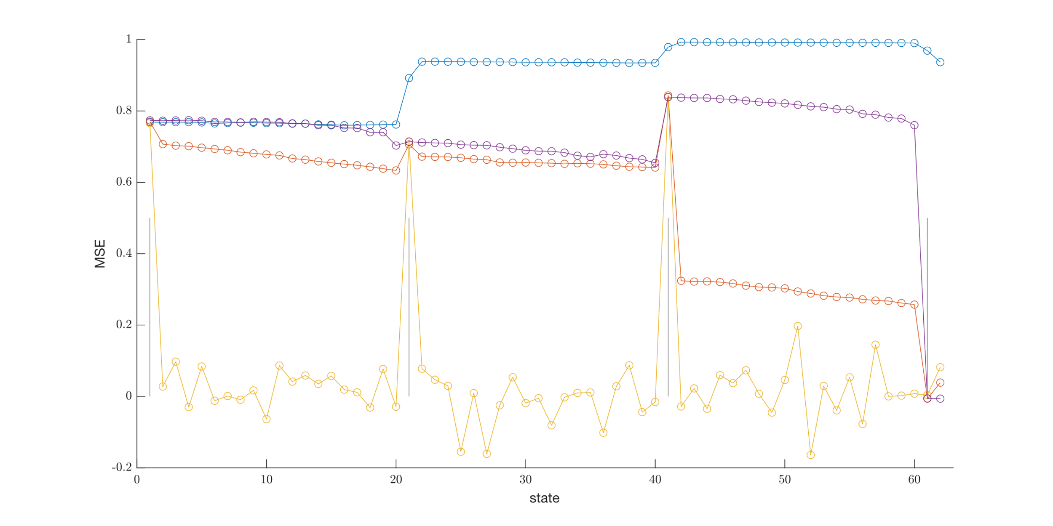
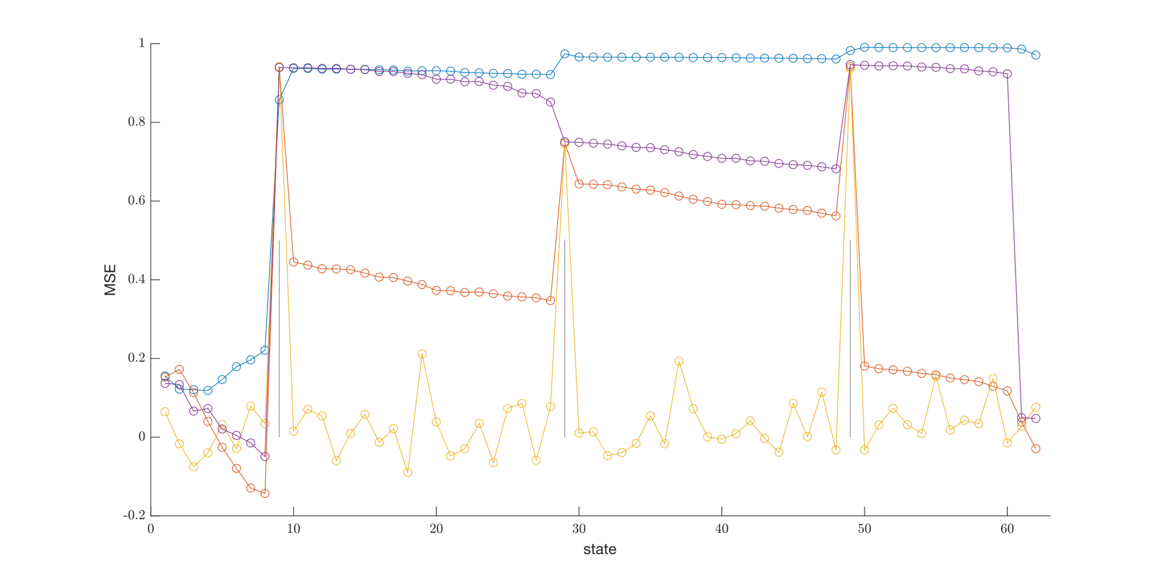
#1: Tonic burst + late
#3: Tonic burst
#2: Tonic tonic
#4: Tonic low tonic
Corr 0
Corr 4

Slide 3
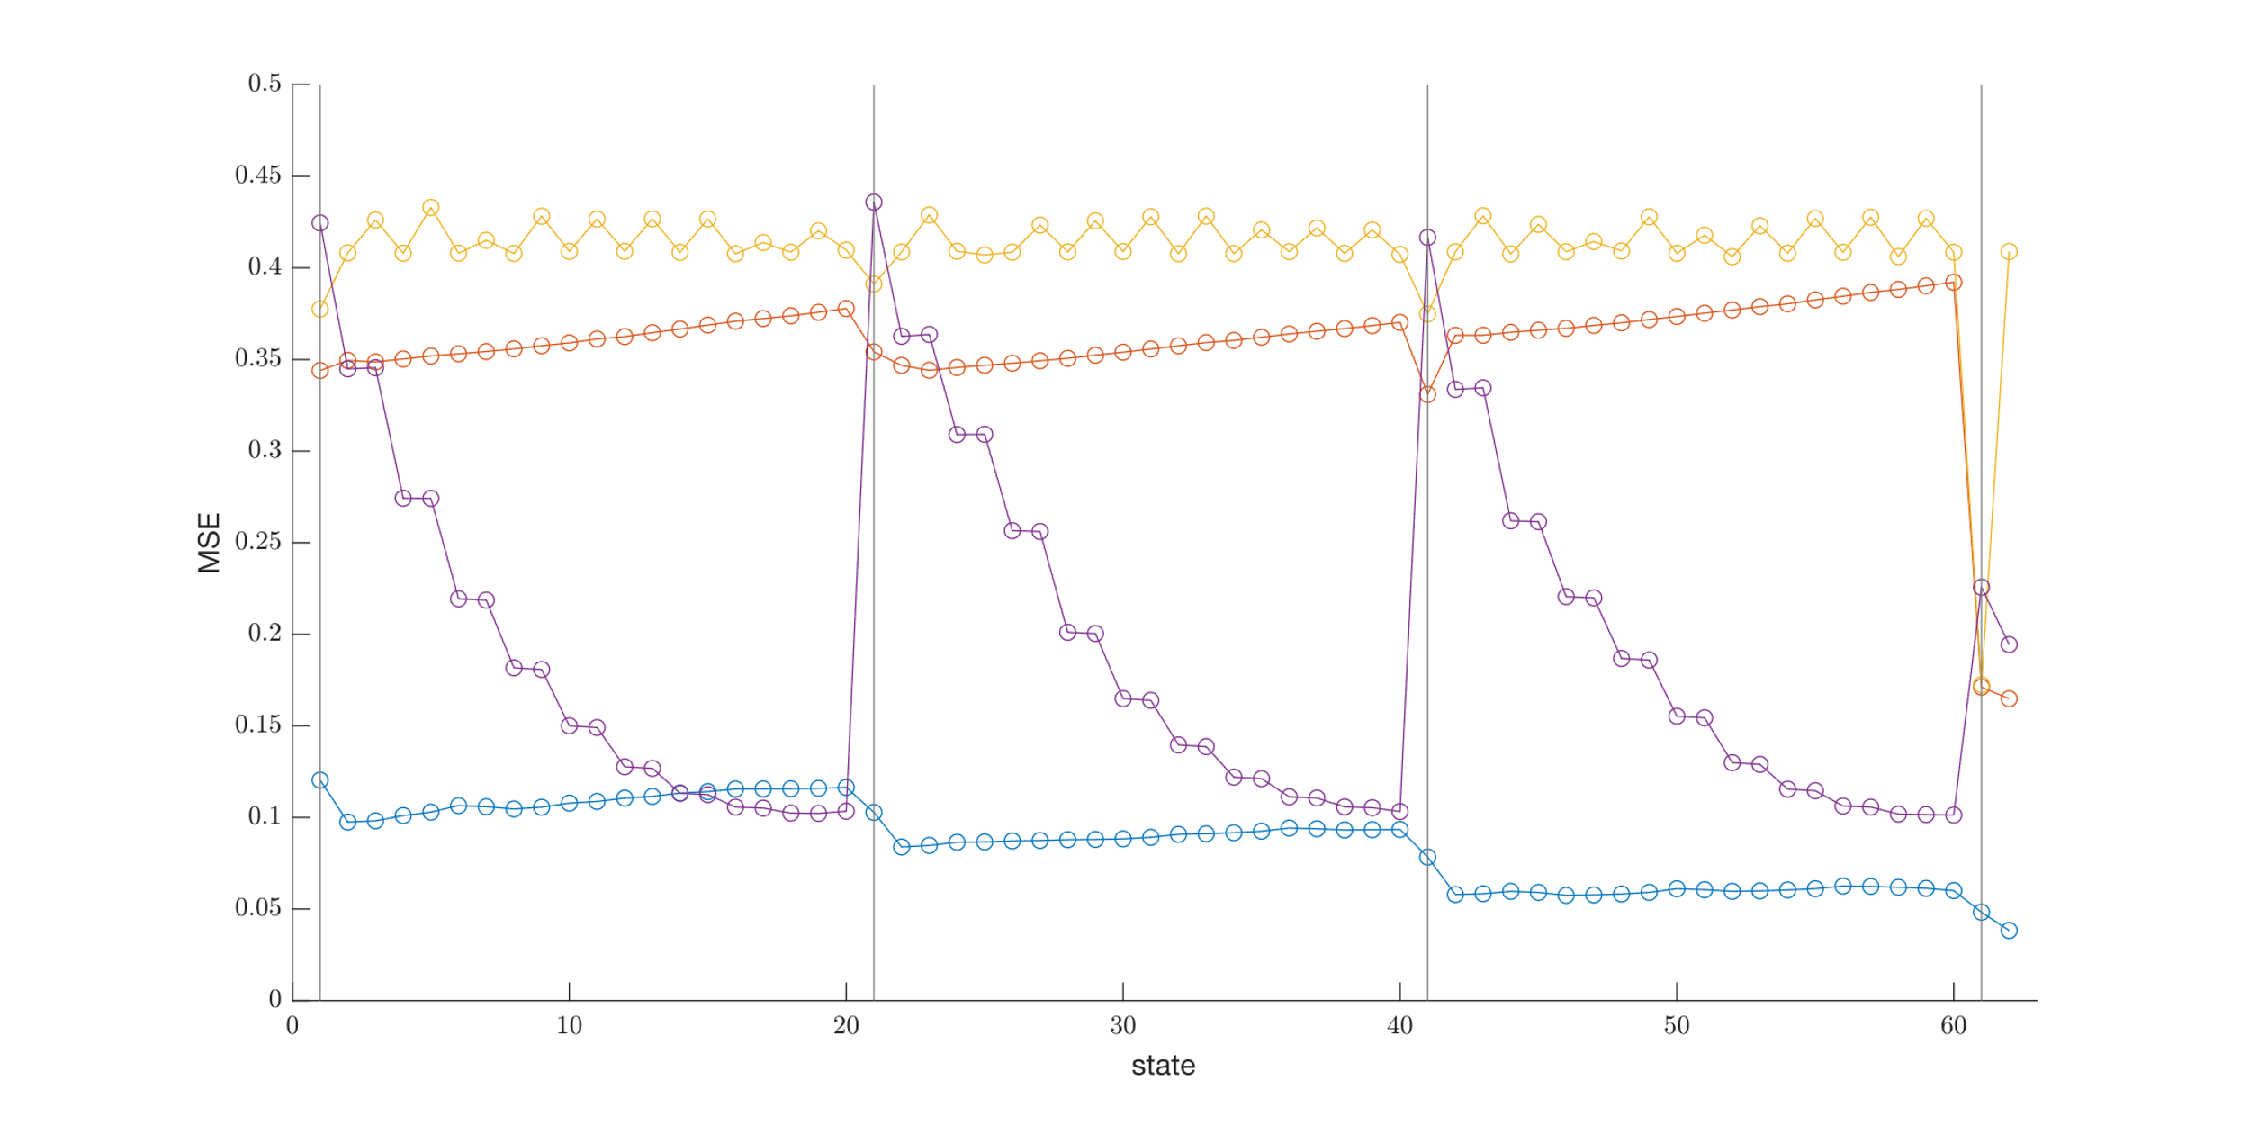
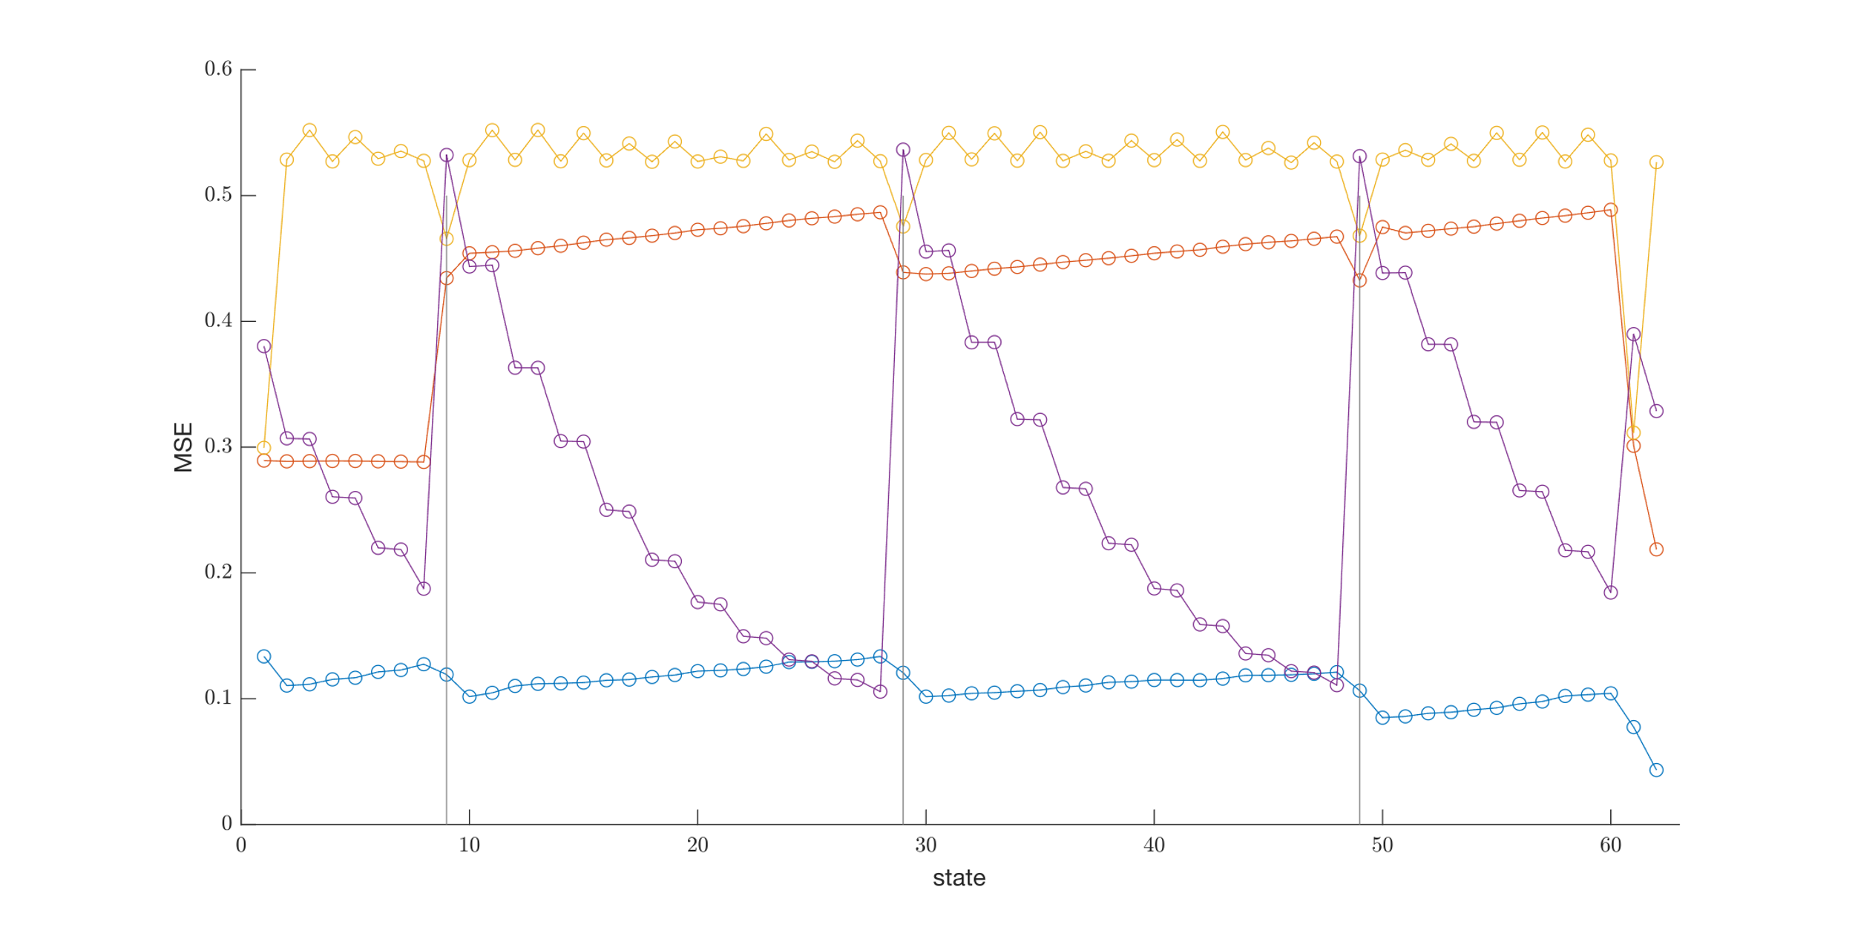
MSE 0
MSE 4

Slide 4
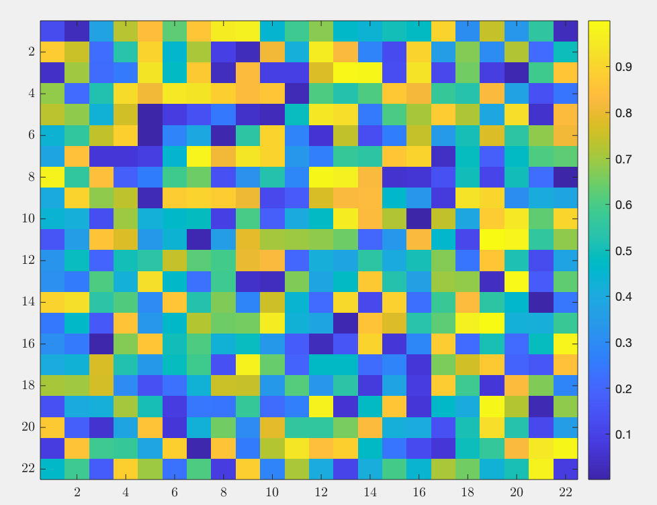
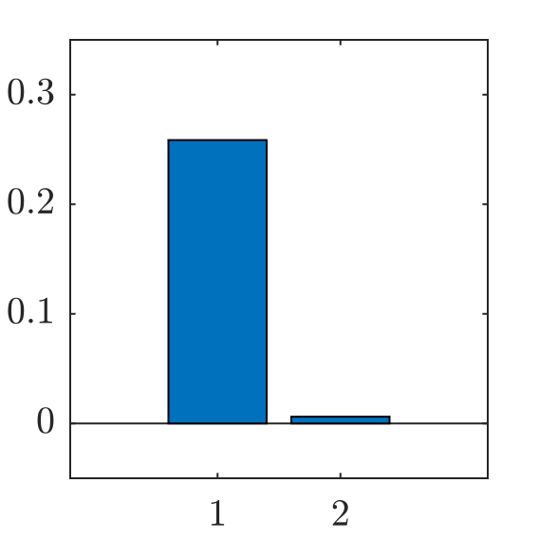
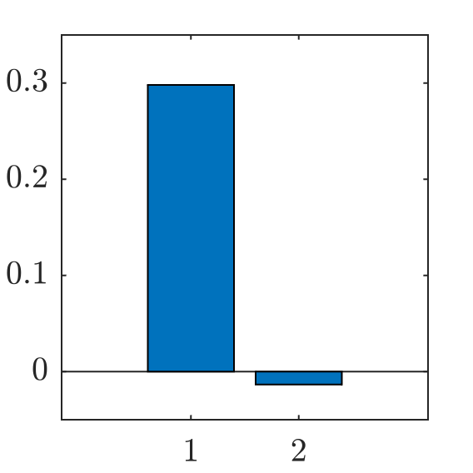
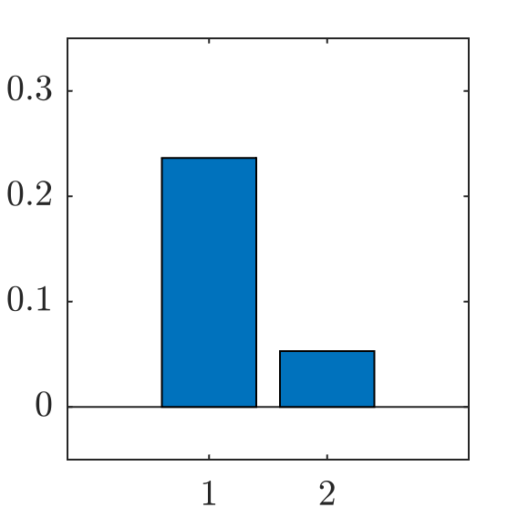
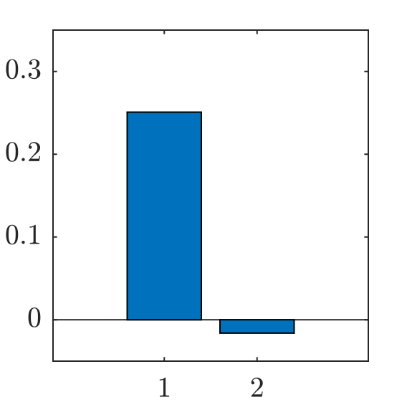
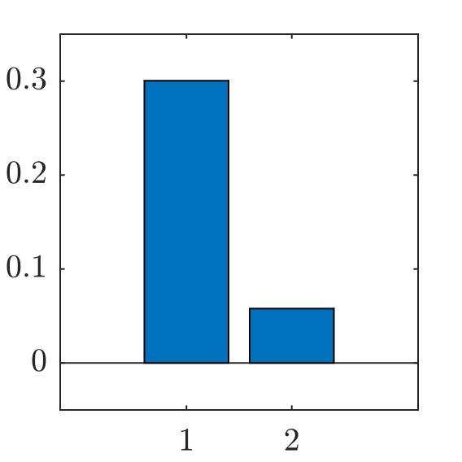
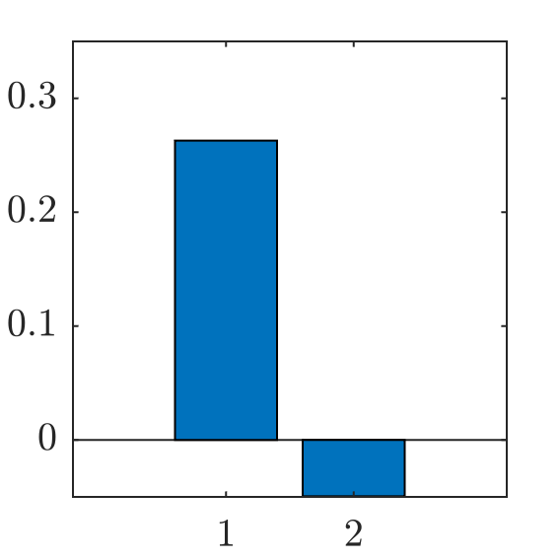
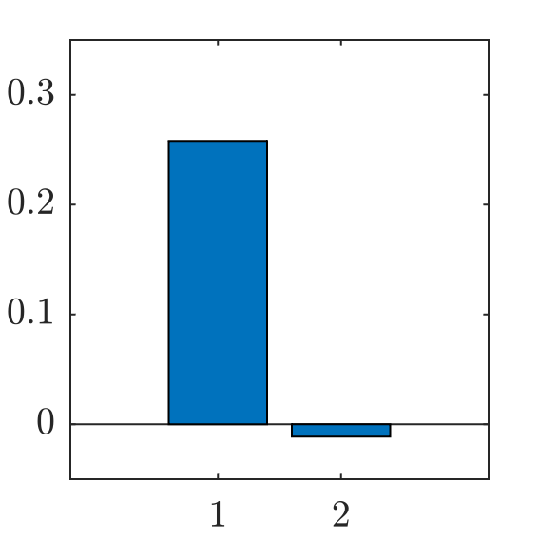
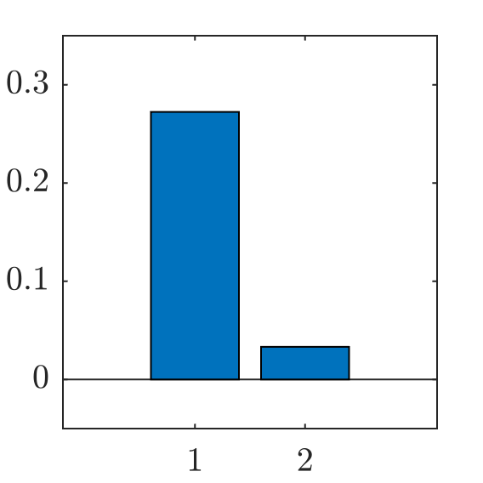
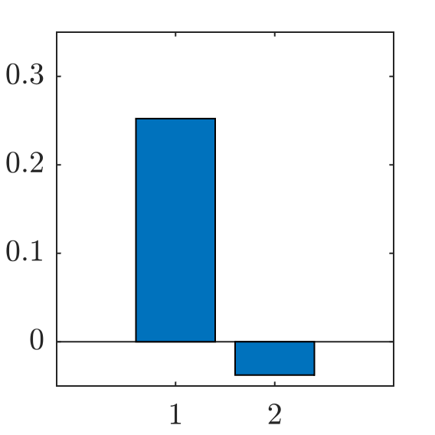
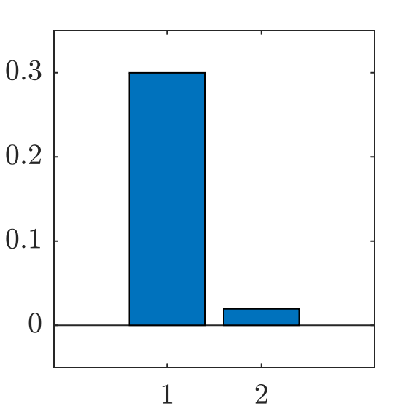
0
1
2
3
4
5
6
7
8
9
MSE
Corr
MSE
Corr
MSE
Corr
MSE
Corr
MSE
Corr

Slide 5
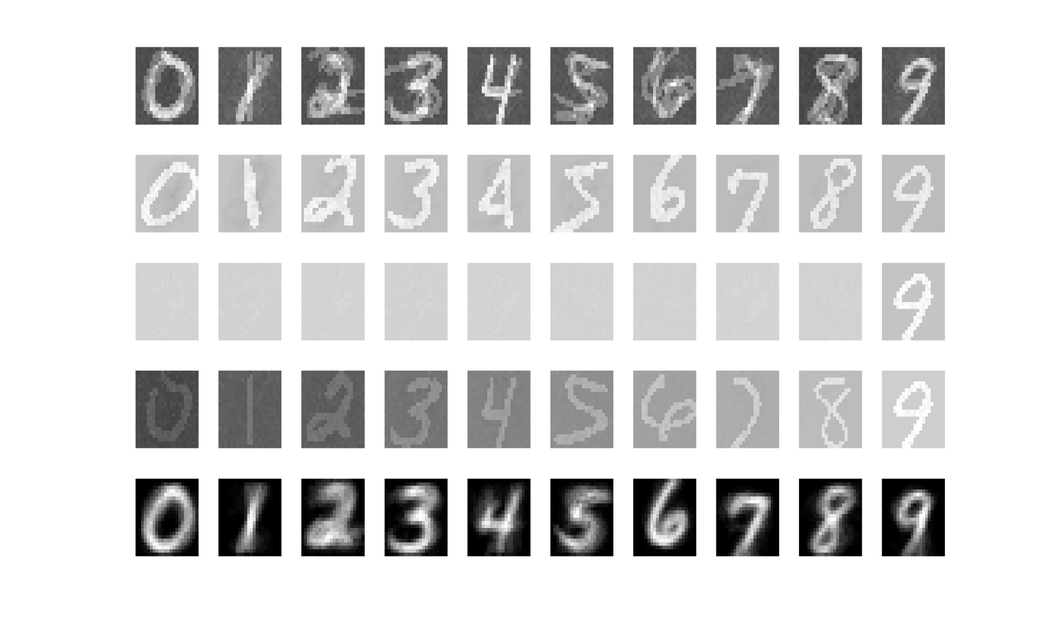


Slide 6
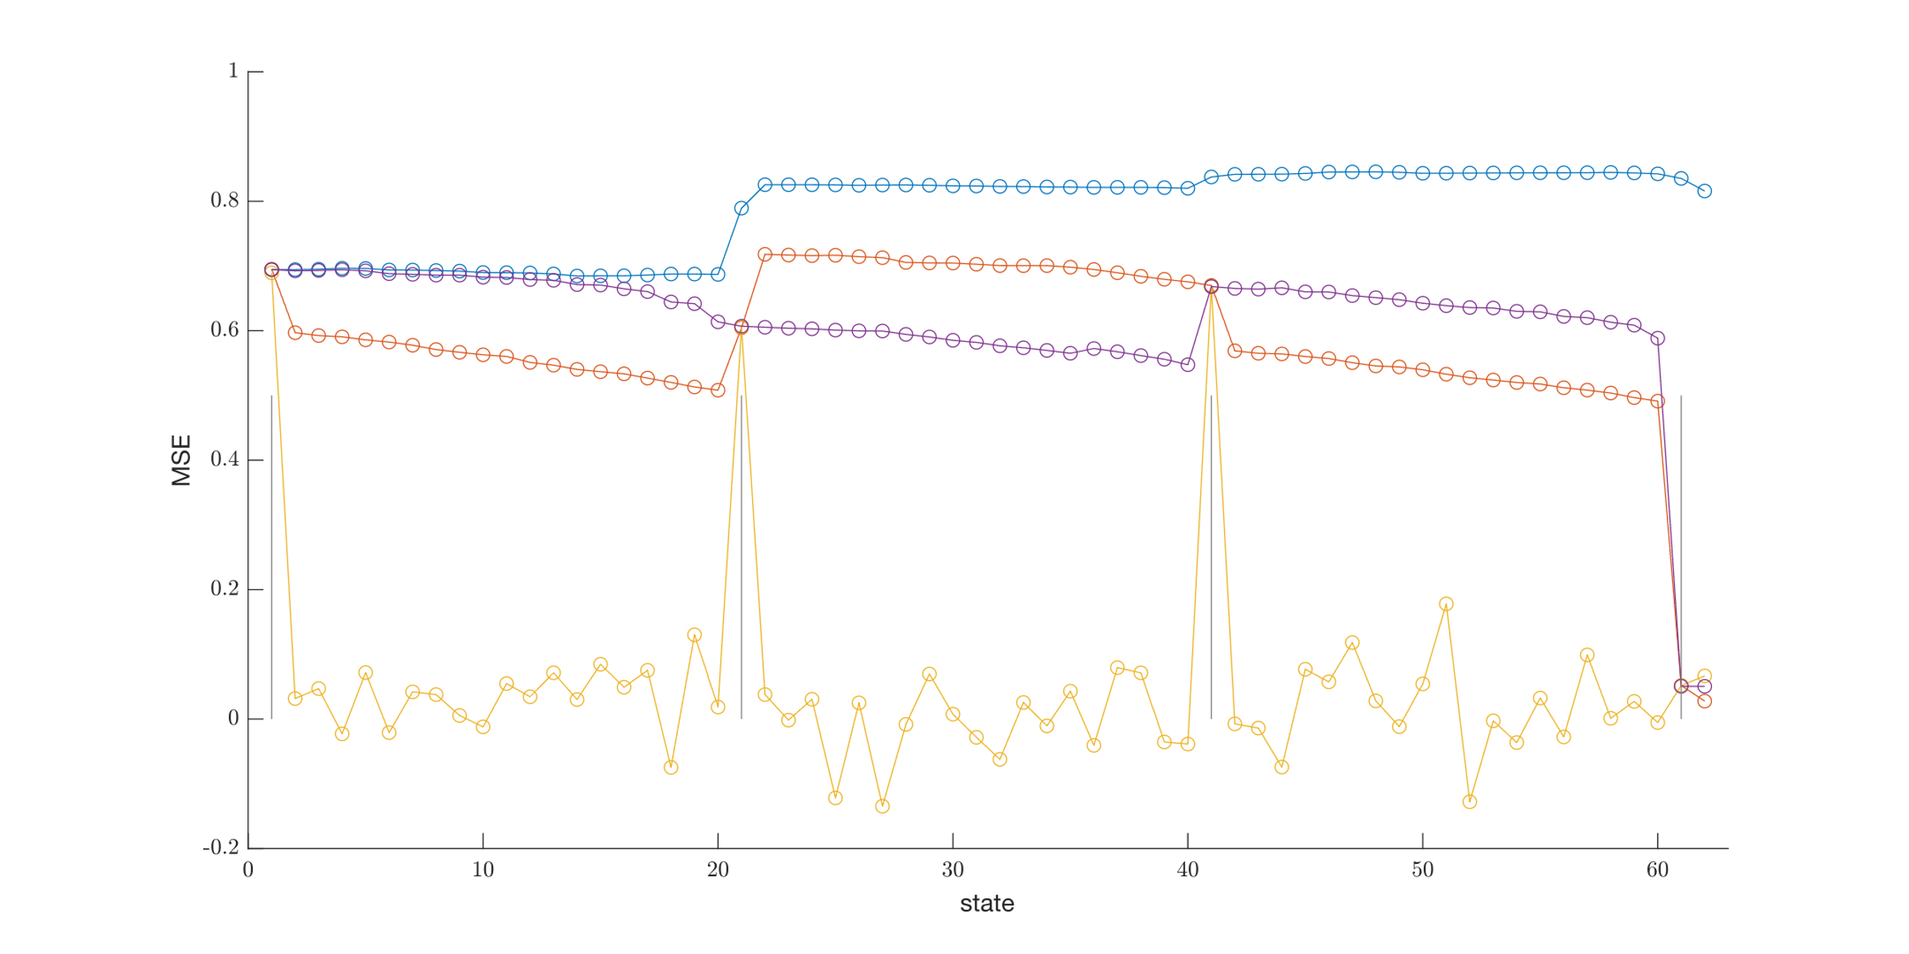
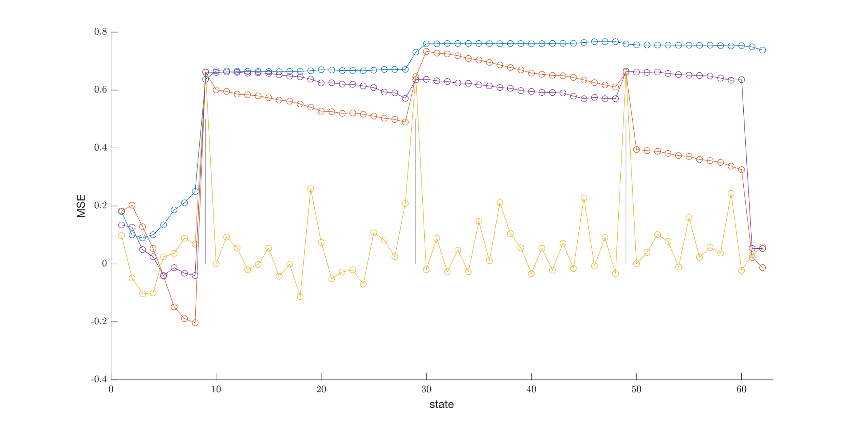
Corr 0
Corr 4

Slide 7
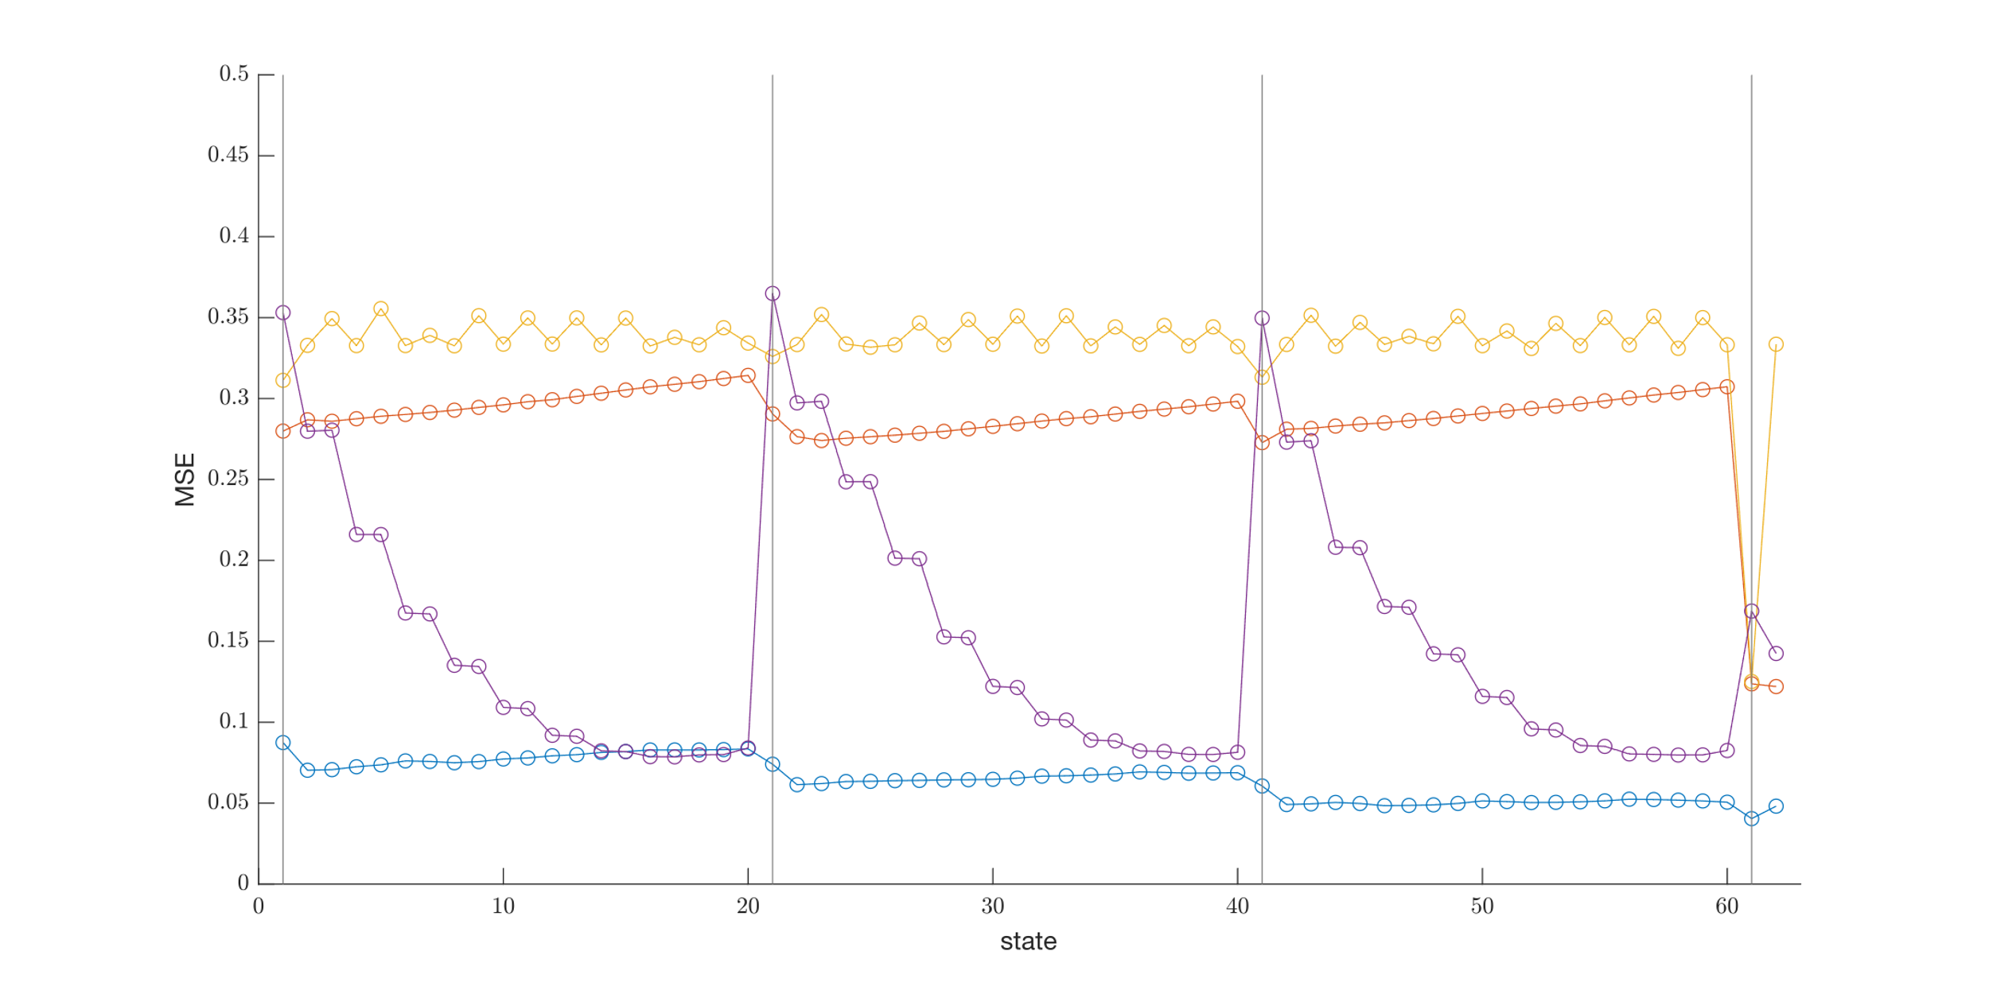
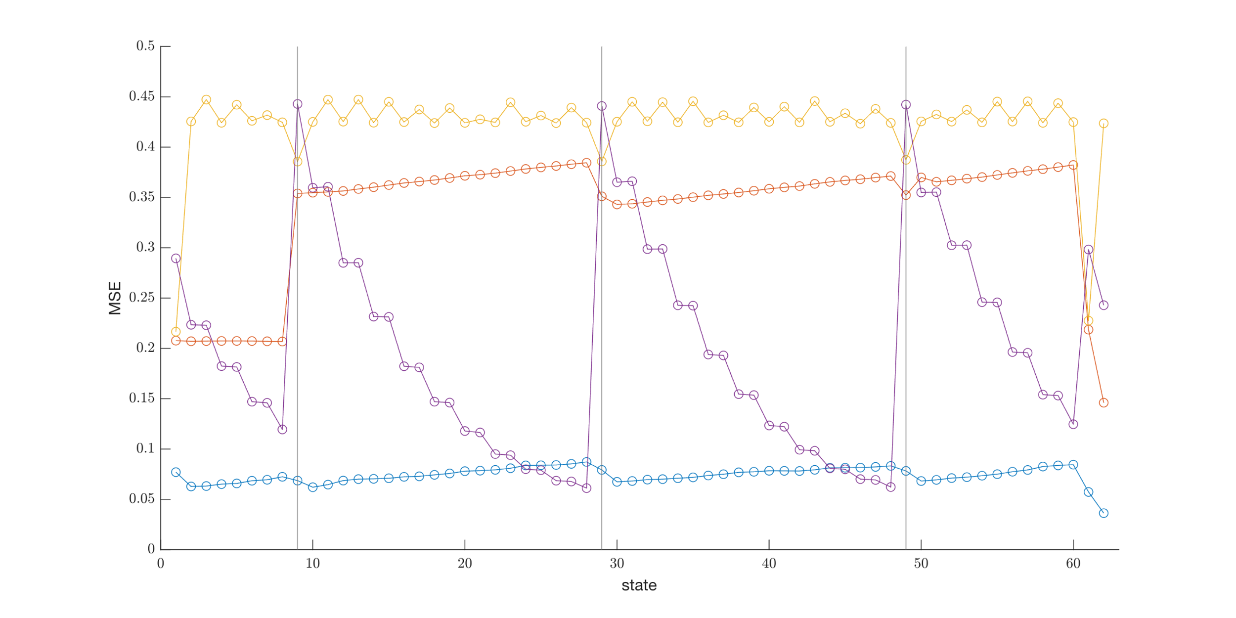
Corr 0
MSE 0
Corr 4
MSE 4

